Slide 1

LX Introduction to Machine Learning
Z. Gu 2021

Slide 2
ML Taxonomy
Supervised Learning:
The system is presented with example inputs and their desired outputs, given by a “teacher”, and the goal is to learn a general rule that maps inputs to outputs.
Classification (cat or dog?)
Regression (housing price next year?)
Unsupervised Learning:
No labels are given to the learning algorithm, leaving it on its own to find structure in its input. Unsupervised learning can be a goal in itself (discovering hidden patterns in data) or a means towards an end (feature learning).
Parametric UL (e.g., Gaussian Mixture Models)
Non-parametric UL
Notes:
Three categories
Supervised learning (w. labeled data), incl.
Classification (cat vs. dog?)
Regression (housing price next year?)
Unsupervised learning (no labeled data), incl.
Custering
Game playing (AlphaGo)
Deep Learning (DL) is a type of ML algorithm that is based on neural networks
Many other ML algorithms besides DL

Slide 3

ML Taxonomy
Reinforcement Learning:
An agent interacts with a dynamic environment in which it must perform a certain goal. The agent is provided feedback in terms of rewards and it tries to learn an optimal policy that maximizes its cumulative rewards.
Algorithms: Model-based; Model-free (Value-based, Policy-based)
Applications: Game playing (AlphaGo); Robotics; AD…

Slide 4
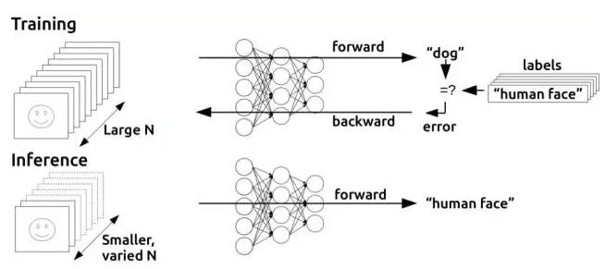
Training vs. Inference
Training: millions of iterations of forward pass + back propagation to adjust model params (e.g., NN weights); requires large CPU/GPU clusters and days/weeks of training time
Inference (also called prediction): a single forward pass; can be run on edge devices

Slide 5
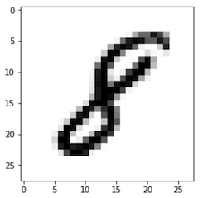
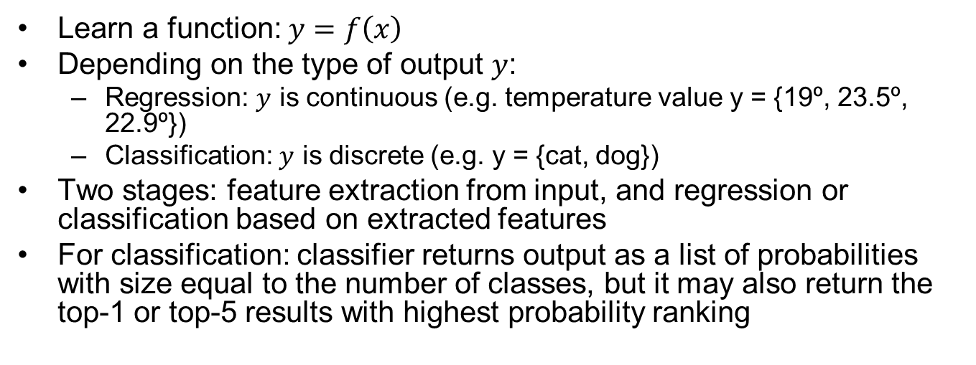
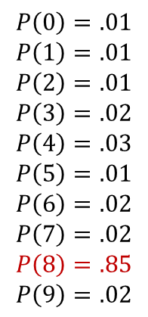
Supervised Learning
Learn a function: $y=f\left(x\right)$
Depending on the type of output $y$:
Regression: $y$ is continuous (e.g. temperature value y = {19º, 23.5º, 22.9º})
Classification: $y$ is discrete (e.g. y = {cat, dog})
Two stages: feature extraction from input, and regression or classification based on extracted features
For classification: classifier returns output as a list of probabilities with size equal to the number of classes, but it may also return the top-1 or top-5 results with highest probability ranking
$$P\left(0\right)=.01$$
$$P\left(1\right)=.01$$
$$P\left(2\right)=.01$$
$$P\left(3\right)=.02$$
$$P\left(4\right)=.03$$
$$P\left(5\right)=.01$$
$$P\left(6\right)=.02$$
$$P\left(7\right)=.02$$
$$P\left(8\right)=.85$$
$$P\left(9\right)=.02$$
Feature
Extraction
Classifier
Sum
to 1.0

Slide 6
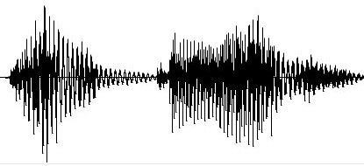

Classification Example: Automatic Speech Recognition
s1
Designed feature extraction
s2
Classifier
“hola que tal”
Learned
s3
Hand-crafted acoustic features
End2end model
Learned
feature extraction
Classifier
“hola que tal”
All params are learned. Model maps raw inputs to raw outputs, no intermediate blocks.

Slide 7
Regression Example: Text to Speech Synthesis
ft 1
s1
Designed feature extraction
ft 2
Regression module
s2
TXT
wavegen
ft 3
s3
“Hand-crafted” features
“Hand-crafted” features
Notes:
: Textual features → Spectrum of speech (many coefficients)

Slide 8
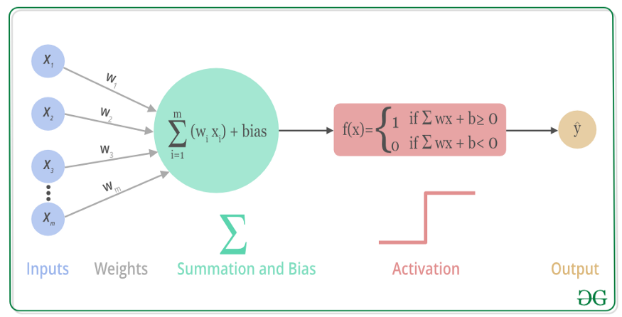
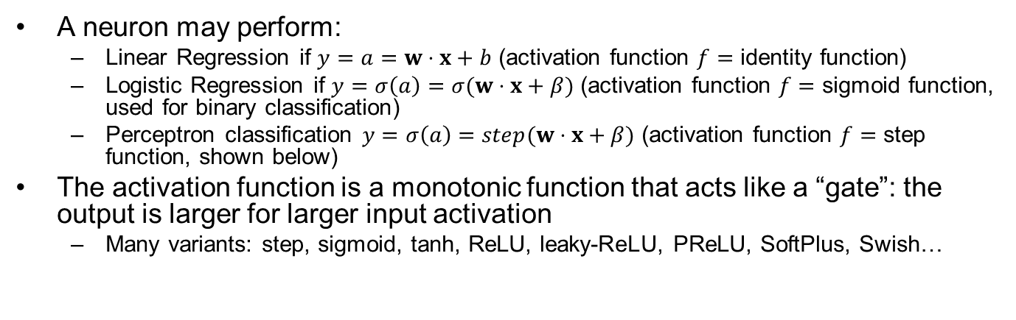
A Neuron and its Activation Function
A neuron may perform:
Linear Regression if $y=a=w⋅x+b$ (activation function $f=$ identity function)
Logistic Regression if $y=σ\left(a\right)=σ(w⋅x+β)$ (activation function $f=$ sigmoid function, used for binary classification)
Perceptron classification $y=σ\left(a\right)=step(w⋅x+β)$ (activation function $f=$ step function, shown below)
The activation function is a monotonic function that acts like a “gate”: the output is larger for larger input activation
Many variants: step, sigmoid, tanh, ReLU, leaky-ReLU, PReLU, SoftPlus, Swish…

Slide 9
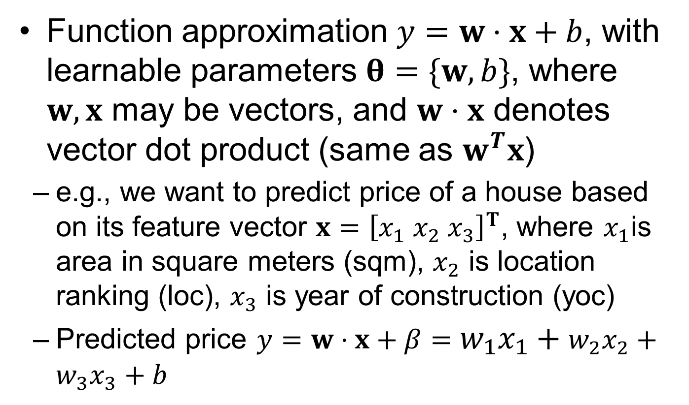
Linear Regression
Function approximation $y=w⋅x+b$, with learnable parameters $θ=\{w,b\}$, where $w,x$ may be vectors, and $w⋅x$ denotes vector dot product (same as $w^{T}x$)
e.g., we want to predict price of a house based on its feature vector $x={\left[x_{1} x_{2} x_{3}\right]}^{T}$, where $x_{1}$is area in square meters (sqm), $x_{2}$ is location ranking (loc), $x_{3}$ is year of construction (yoc)
Predicted price $y=w⋅x+β=w_{1}x_{1}+w_{2}x_{2}+w_{3}x_{3}+b$

Slide 10
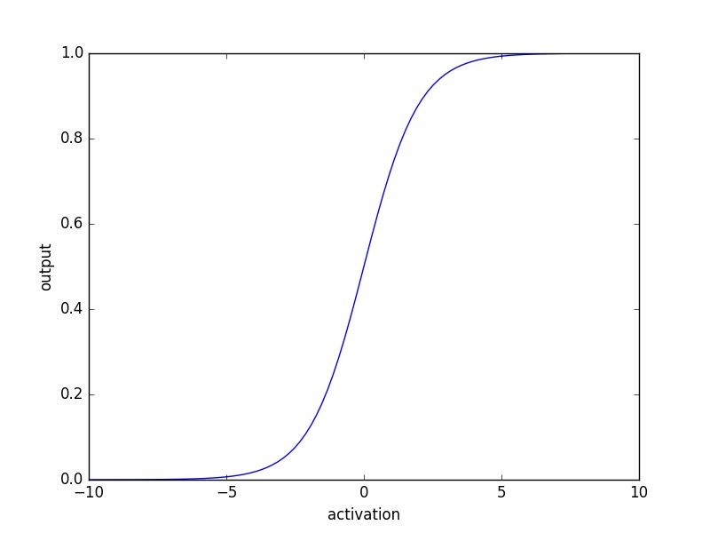
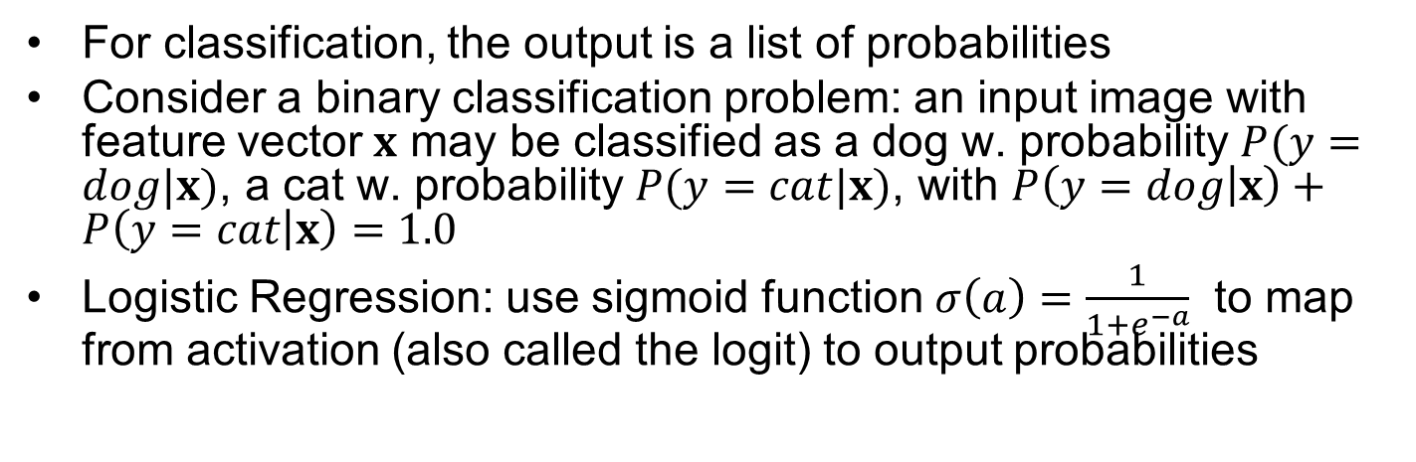
Logistic Regression w. Sigmoid Function
For classification, the output is a list of probabilities
Consider a binary classification problem: an input image with feature vector $x$ may be classified as a dog w. probability $P(y=dog|x)$, a cat w. probability $P(y=cat|x)$, with $P\left(y=dog | x\right)+P\left(y=cat | x\right)=1.0$
Logistic Regression: use sigmoid function $σ\left(a\right)=\frac{1}{1+e^{−a}}$ to map from activation (also called the logit) to output probabilities

Slide 11
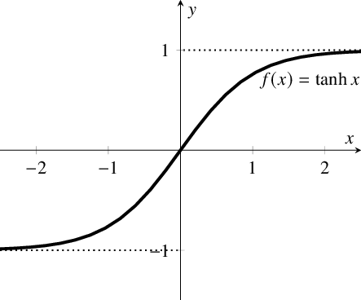
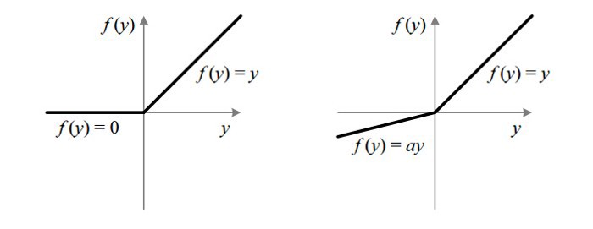
Common Activation Functions used in DL
sigmoid
tanh
ReLU
Leaky ReLU

Slide 12
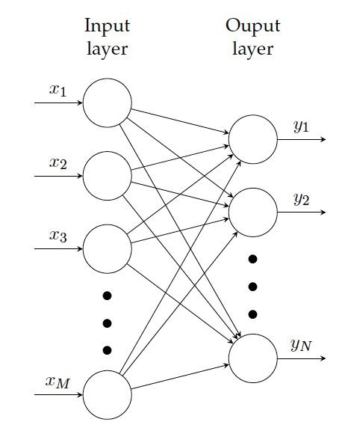
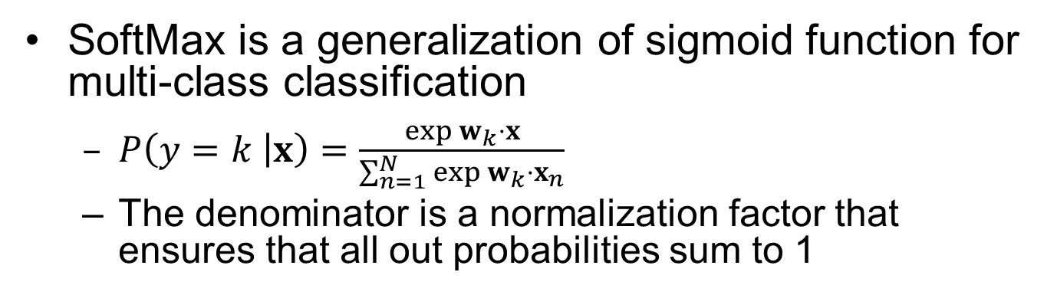
SoftMax Activation Function
SoftMax is a generalization of sigmoid function for multi-class classification
$P\left(y=k | x\right)=\frac{\exp{w_{k}⋅x}}{\sum_{n=1}^{N}{{\exp{w_{k}⋅x}}_{n}}}$
The denominator is a normalization factor that ensures that all out probabilities sum to 1
Input iimage pixels
0.3 “dog”
0.08 “cat”
0.53 “horse”
All output P’s sum to 1

Slide 13
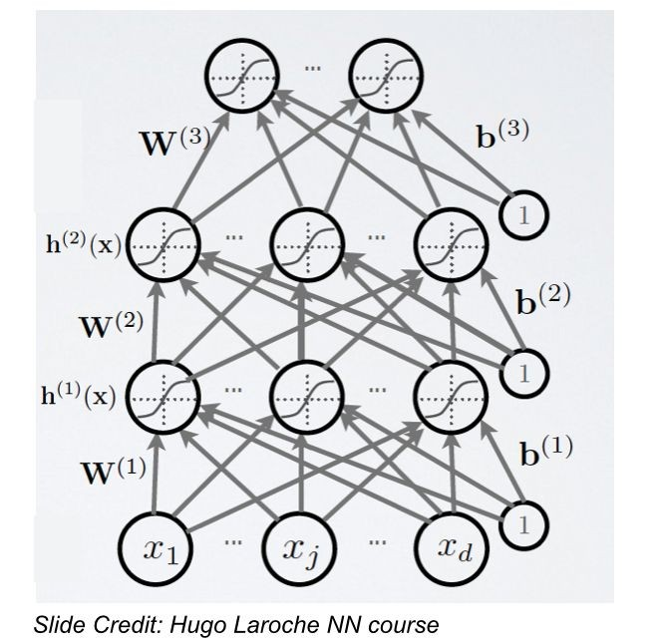
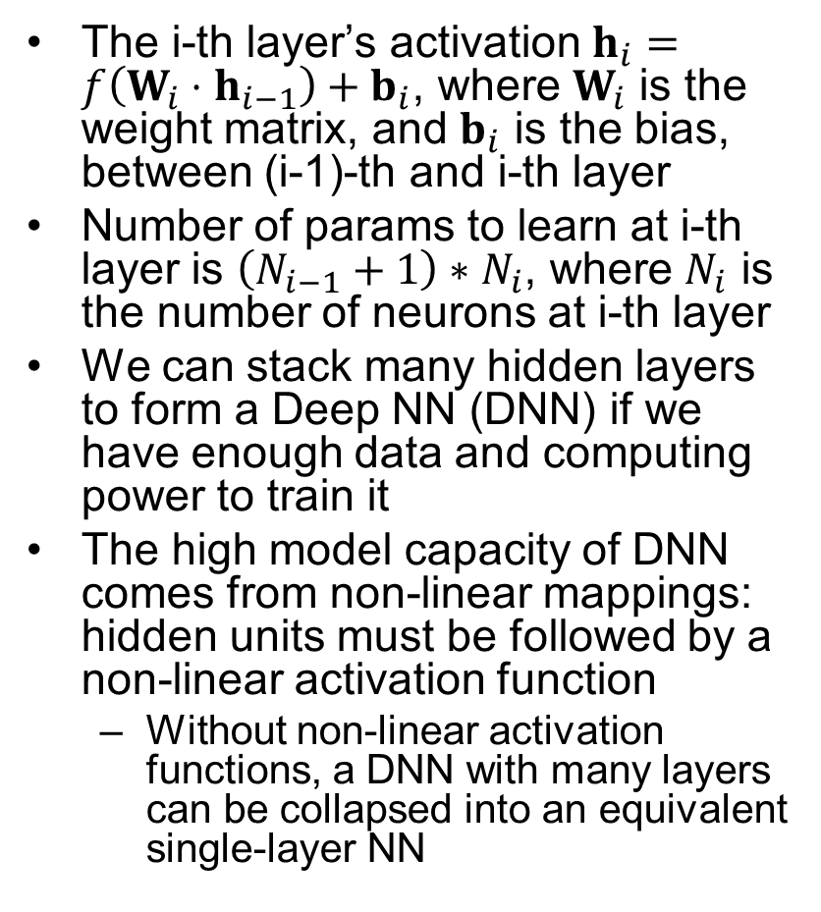
A Fully-Connected Neural Network
The i-th layer’s activation $h_{i}=f\left(W_{i}⋅h_{i−1}\right)+b_{i}$, where $W_{i}$ is the weight matrix, and $b_{i}$ is the bias, between (i-1)-th and i-th layer
Number of params to learn at i-th layer is $\left(N_{i−1}+1\right)∗N_{i}$, where $N_{i}$ is the number of neurons at i-th layer
We can stack many hidden layers to form a Deep NN (DNN) if we have enough data and computing power to train it
The high model capacity of DNN comes from non-linear mappings: hidden units must be followed by a non-linear activation function
Without non-linear activation functions, a DNN with many layers can be collapsed into an equivalent single-layer NN

Slide 14
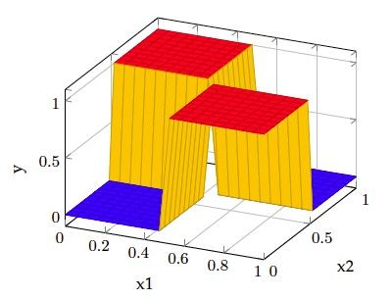
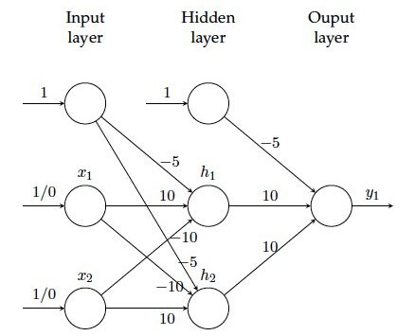
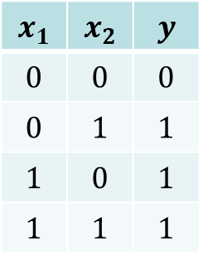
Example: Two-Layer NN for Solving XOR
The NN consists of one input, one hidden, and one output layer, with sigmoid activations
2 hidden units with sigmoid activations
$$x_{1}$$ | $$x_{2}$$ | $$y$$
$$0$$ | $$0$$ | $$0$$
$$0$$ | $$1$$ | $$1$$
$$1$$ | $$0$$ | $$1$$
$$1$$ | $$1$$ | $$1$$
output unit with sigmoid activation

Slide 15
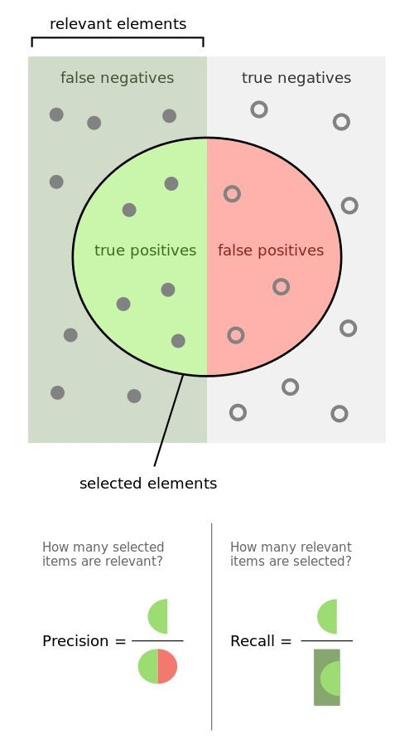
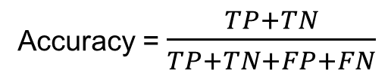
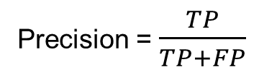
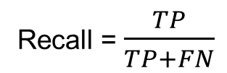
Binary Classification Metrics
The relevant class is considered “positive” in a binary classifier
e.g., for a medical test that aims to diagnose people with a certain disease. “Positive” denotes sick (has disease), and “negative” denotes healthy (no disease)
TP: a sick person is diagnosed as sick
TN: a healthy person is diagnosed as healthy
FP: a healthy person is misdiagnosed as sick
FN: a sick person is misdiagnosed as healthy
 |  | Prediction
 |  | Positives | Negatives
Ground Truth | Positives | True positive (TP) | False negative (FN)
 | Negatives | False positives (FP)
Recall = $\frac{TP}{TP+FN}$
Precision = $\frac{TP}{TP+FP}$
Accuracy = $\frac{TP+TN}{TP+TN+FP+FN}$

Slide 16
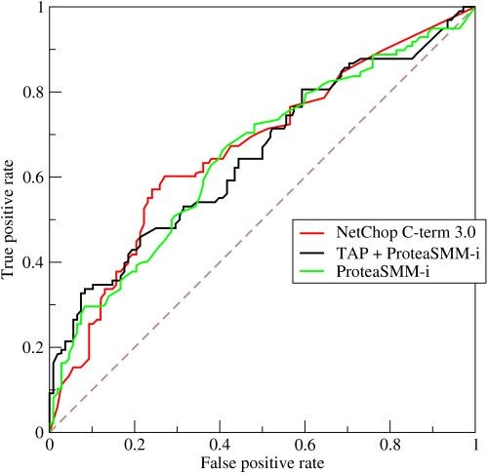
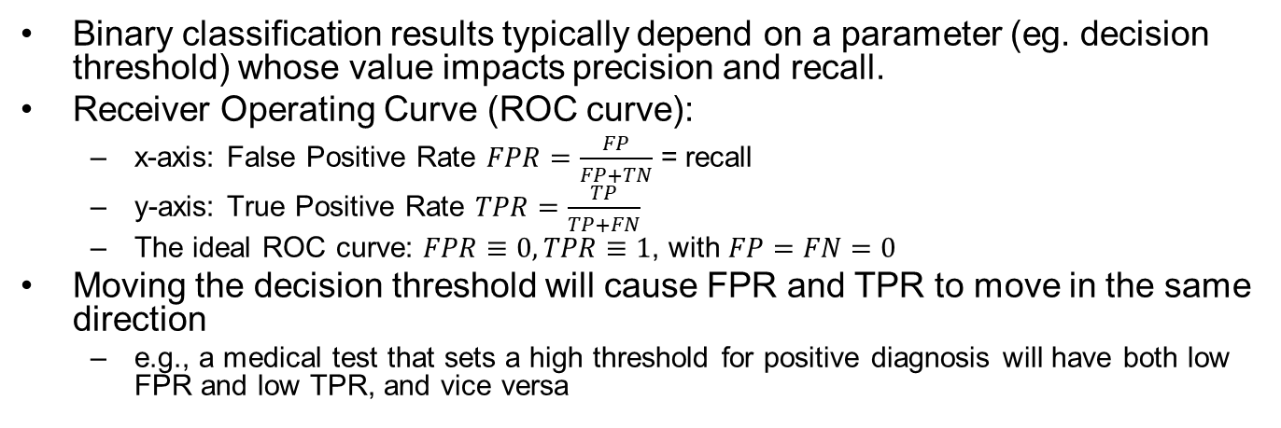
ROC Curve
Binary classification results typically depend on a parameter (eg. decision threshold) whose value impacts precision and recall.
Receiver Operating Curve (ROC curve):
x-axis: False Positive Rate $FPR=\frac{FP}{FP+TN}$ = recall
y-axis: True Positive Rate $TPR=\frac{TP}{TP+FN}$
The ideal ROC curve: $FPR≡0,TPR≡1$, with $FP=FN=0$
Moving the decision threshold will cause FPR and TPR to move in the same direction
e.g., a medical test that sets a high threshold for positive diagnosis will have both low FPR and low TPR, and vice versa

Slide 17
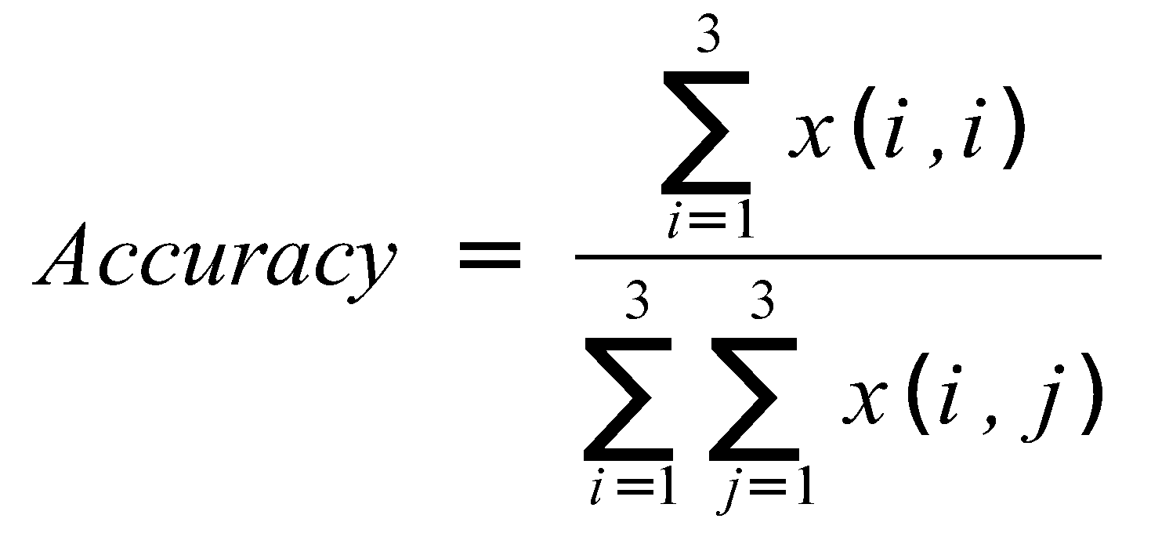
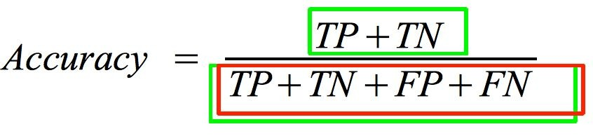
Confusion Matrix for Multi-Class Classification
Binary classification as a special case of multi-class classification:
Binary
 |  | Prediction
 |  | Class 1 | Class 2 | Class 3
Ground Truth | Class 1 | x(1,1) | x(1,2) | x(1,3)
 | Class 2 | x(2,1) | x(2,2) | x(2,3)
 | Class 3 | x(3,1) | x(3,2) | x(3,3)
 |  | Prediction
 |  | Positives | negative
Ground Truth | Positives | True positive (TP) | False negative (FN)
 | Negative | False positives (FP) | True negative (TN)

Slide 18
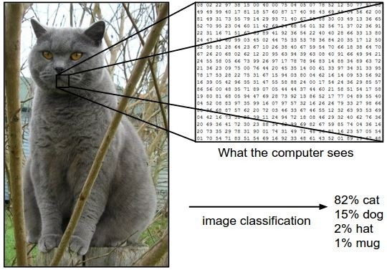
The Image Classification Problem
A color image is represented as 3D arrays of numbers, with integers between [0, 255] denoting pixel intensities.
e.g. 300x100x3 (3 color channels, e.g., RGB)

Slide 19
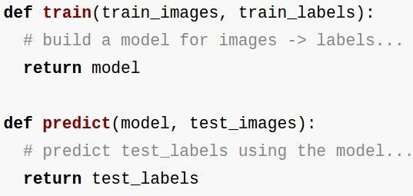
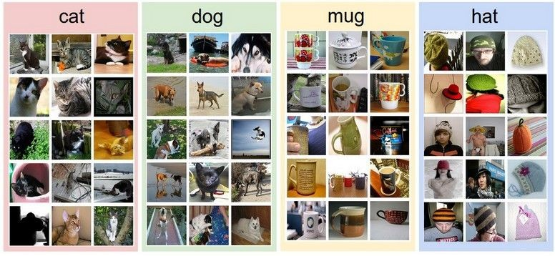
The ML Approach
Collect a dataset of images and labels
Use Machine Learning to train an image classifier
Evaluate the classifier on test images
Example training set

Slide 20
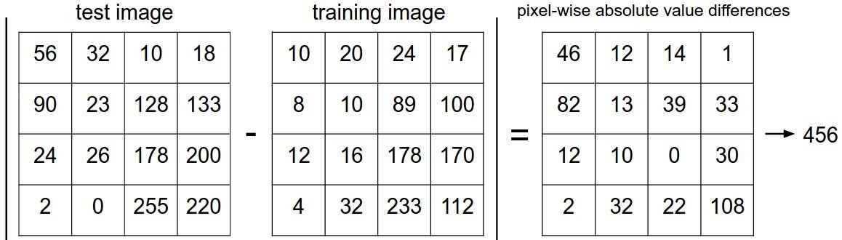
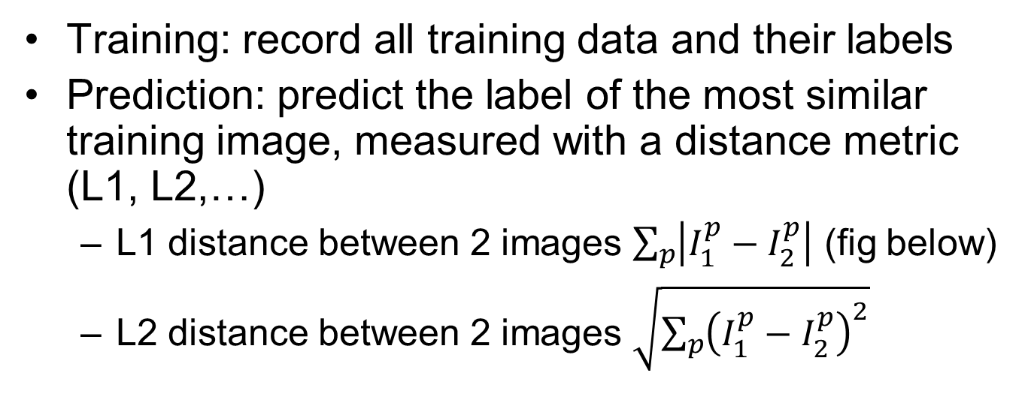
Naïve Method: Nearest Neighbor Classifier
Training: record all training data and their labels
Prediction: predict the label of the most similar training image, measured with a distance metric (L1, L2,…)
L1 distance between 2 images $\sum_{p}{\left|I_{1}^{p}−I_{2}^{p}\right|}$ (fig below)
L2 distance between 2 images $\sqrt{\sum_{p}{{\left(I_{1}^{p}−I_{2}^{p}\right)}^{2}}}$
add

Slide 21
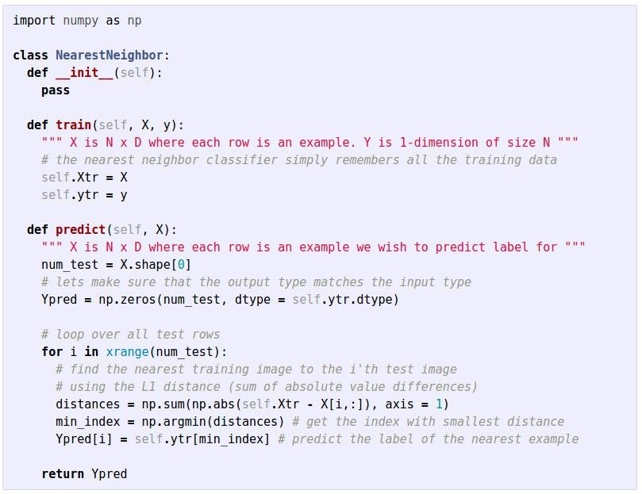
Code for Nearest Neighbor Classifier
Not practical, since prediction time grows linearly with training dataset size

Slide 22
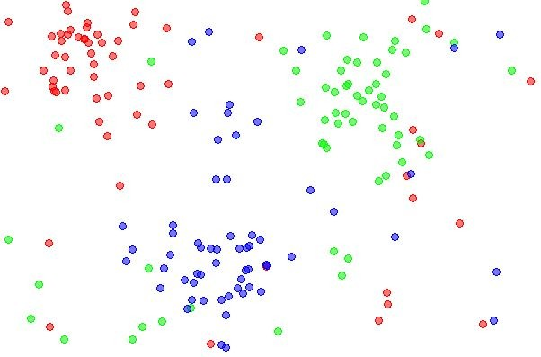
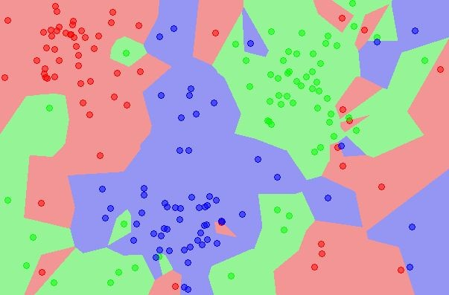
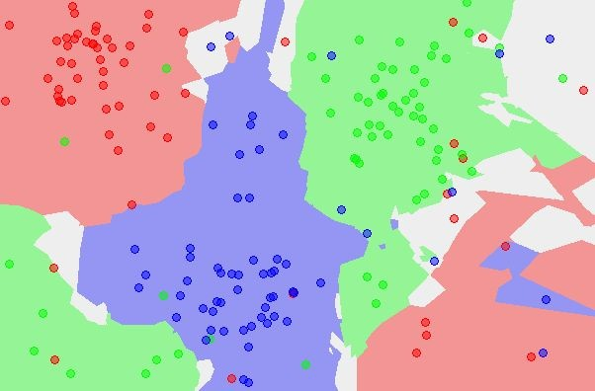
k-Nearest Neighbor (KNN)
Find the k nearest images, have them vote on the label
A practical and widely-used technique
Hyper-parameters: the distance metric (L1, L2…), neighbor size k need to be tuned for each problem.
the data
NN classifier
5-NN classifier
http://en.wikipedia.org/wiki/K-nearest_neighbors_algorithm

Slide 23
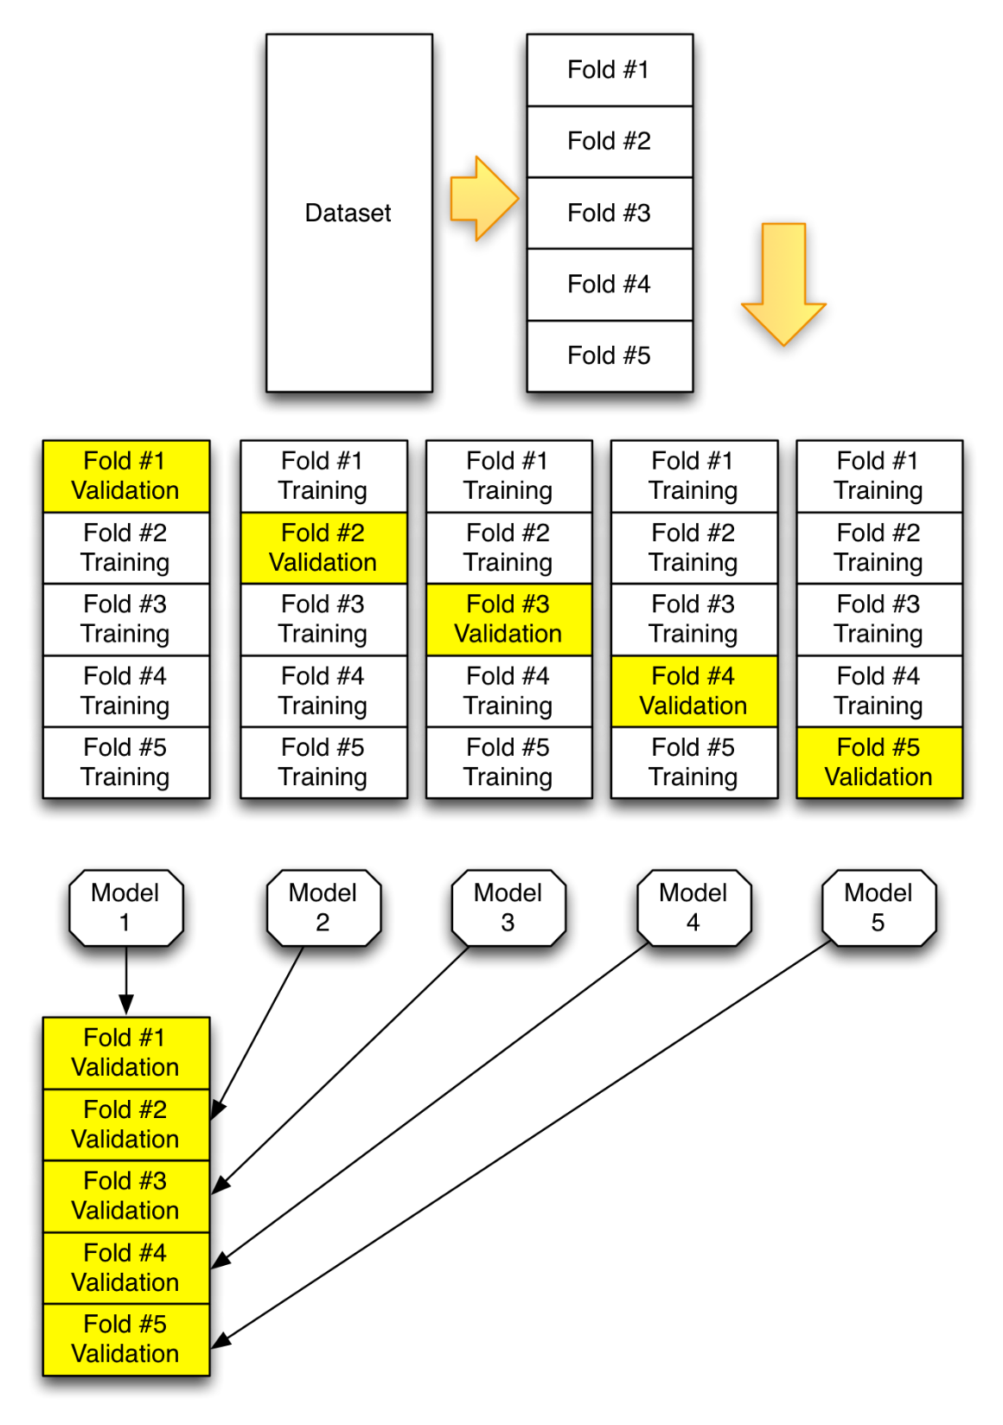
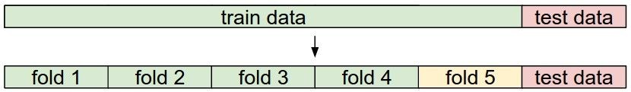
K-Fold Cross-Validation
Divide data into train data and test data
Since we cannot peek at the test data during training time, we use part of the train data for Cross-Validation:
e.g., Divide training data into K=5 parts (folds). Use each fold as validation data, and the other 4 folds as training data. Cycle through the choice of which fold used for validation and average results.
https://github.com/jeffheaton/t81_558_deep_learning/blob/master/t81_558_class_05_2_kfold.ipynb

Slide 24
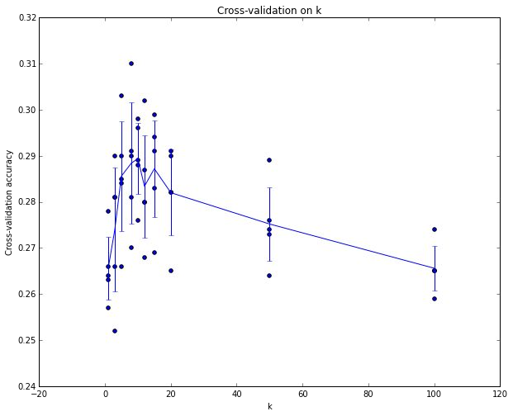
Cross-Validation Example
Example of 5-fold cross-validation for the value of k in KNN
Each point: single outcome.
Vertical blue lines indicate standard deviation
Red line indicates that k ~= 7 works best

Slide 25
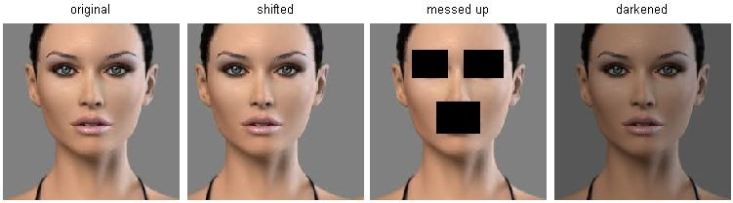
KNN Limitations
L2 distance is not a good metric of human perception
All 3 images on the right (shifted, messed up, darkened) have same L2 distance to the one on the left in pixel space

Slide 26
Pred now contains a 1000 dimensional vector containing the class logits for the 1000 imagenet classes (i.e., if you wanted to convert this to a probability vector, you would apply the softmax operator to this vector). To find the highest likelihood class, we simply take the index of maximum value in this vector, and we can look this up in a list of imagenet classes to find the corresponding label.

Slide 27
Summary
For image classification, we introduced the k-Nearest Neighbor Classifier, which predicts the labels based on nearest images in the training set
The choice of distance metric and the value of k are hyperparameters that are tuned through cross-validation
After hyperparameter tuning, the classifier is evaluated once on the test set
Notes:
- Image Classification: We are given a Training Set of labeled images, asked to predict labels on Test Set. Common to report the Accuracy of predictions (fraction of correctly predicted images)

